Slide 1
CAPSTONE PROJECT
Harnessing Machine Learning for Diabetes Prediction

Slide 2
Outline
Project Overview
Project Goals
Methods
Results
Recommendation
Summary

Slide 3
Project Overview
Background
Problem Statement:
Health risks
Financial challenges
Detection gaps
Significance
Improved patient outcomes, long-term reduction cost, reputation
Dataset: Patient health data, including:
o Demographics (age, gender)
o Health metrics (BMI, HbA1c level, blood glucose)
o Lifestyle factors (smoking history).

Slide 4
Project Goals
Objective: Develop and evaluate machine learning models to predict diabetes effectively.
Key Requirements:
Handle complex and diverse patient data.
Optimize model performance for both recall and precision.
Generate actionable insights for healthcare intervention

Slide 5
Methods
Data Preparation:
Handled missing values and cleaned data.
Engineered features:
Age Group: Young, Middle-aged, Elderly.
BMI Category: Underweight, Normal, Overweight, Obese.
Risk Score: Combined HbA1c level and blood glucose.
Encoded categorical variables (e.g., smoking history).

Slide 6
Methods continues
2. Model Training:
o Built and tested 3 supervised models:
Logistic Regression
Random Forest Classifier
Gradient Boosting Classifier
o Split dataset (80% training, 20% testing).
3. Evaluation:
o Assessed models using metrics: Accuracy, Precision, Recall, F1 Score.
o Visualized results with confusion matrices.

Slide 7
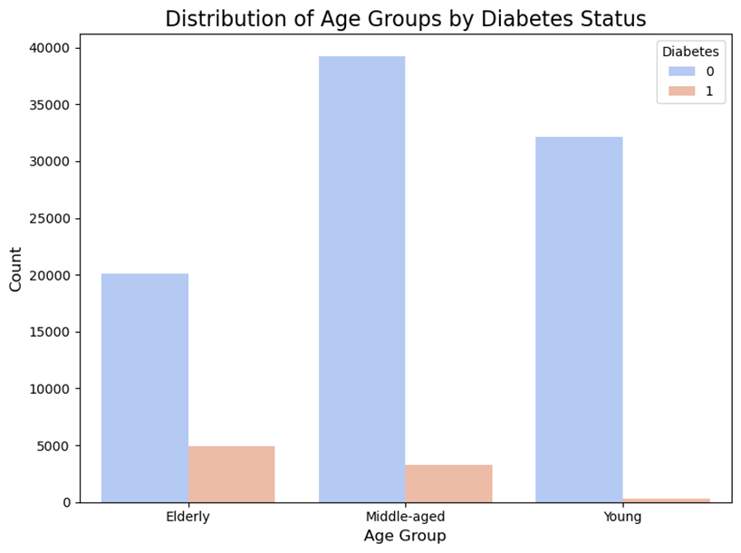
Results (Age Group Distribution)

Slide 8
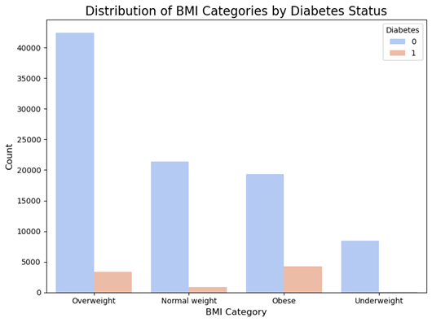
Result continues (BMI Category)

Slide 9
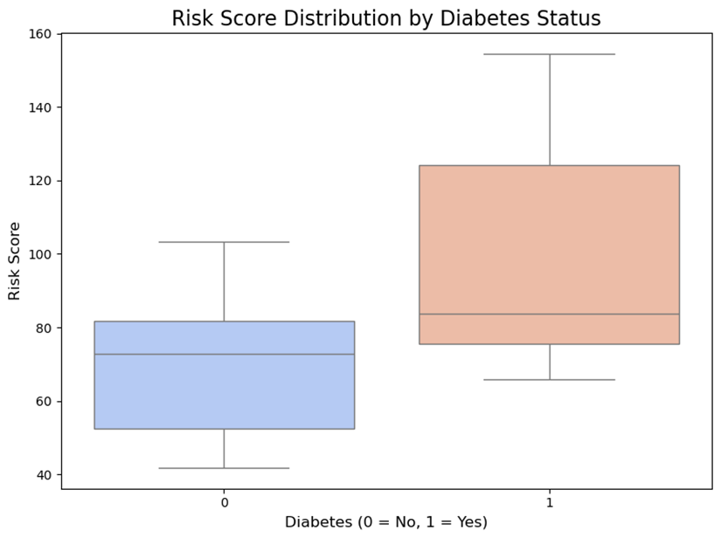
Result continues (Risk Score Distribution)

Slide 10
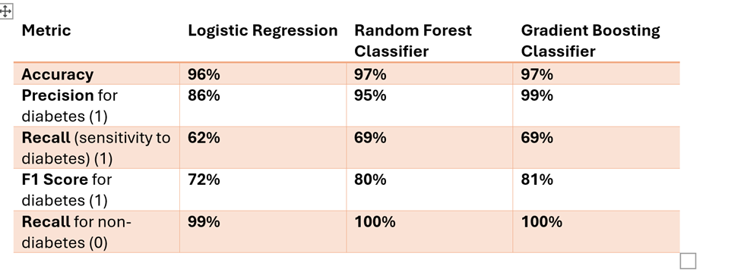
Results (Model Performance and insight)

Slide 11
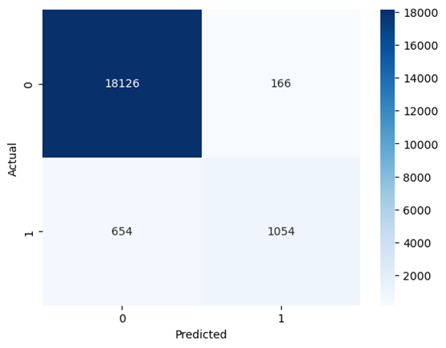
Rsesults (Confusion Matrix)

Slide 12
Results (Metric Derived from Confusion Matrix)
Accuracy : 96.6%
Precision for diabetes : 86.4%
Recall (sensitivity for diabetes) : 61.7%
F1 Score for diabetes : 72.0%
Strenghts
Weaknesses

Slide 13
Key Findings
Diabetes prevalence strongly correlates with obesity and age.
The engineered Risk Score feature effectively separates diabetic and non-diabetic groups.
Moderate recall indicates opportunities for improvement in detecting all diabetes

Slide 14
Recommendations
Feature Enhancement:
Incorporate additional features like family history and physical activity.
2, Awareness Campaigns:
Use findings to target high-risk groups (e.g., elderly and obese).
3.Threshold Optimization:
Adjust model thresholds to prioritize recall and reduce false negatives.

Slide 15
Summary and Impact
This project demonstrates the potential of machine learning to revolutionize diabetes prediction, providing accurate and actionable insights.
Healthcare Benefits:
Timely interventions for high-risk patients.
Reduced long-term healthcare costs.
Business Relevance:
Enhances reputation as a leader in predictive healthcare solutions.
Provides actionable insights for improving patient care.

